Slide 1
Final Project
4/29/13

Slide 2
Pre-Calculus Final Project
GOAL:
Students explore a mathematics topic in more depth, gaining an advanced understanding of the material and real-world applications of it
You will get to choose a topic that interests you

Slide 3
project options
 | Difficulty of Math | Level of Support
Teach Yourself Python (coding) (internet access required) | Medium | Medium
Reddit & Google Algorithms | Medium | Low
Modular Arithmetic and Number Theory | High | Medium
Modular Arithmetic and Encryption | High | Medium
Teach Yourself a New Math Topic! | Variable, depending on topic chosen | Low
Finance - Create a Budget and Educational Materials about one Specialized Topic | Low | Low
Modeling - Space Debris | Medium | High
Modeling – HIV/AIDS Statistics | Low | High
Modeling – College Tuition Increases | Medium | Low
Climate Change | Low | Low
Discover - e | Medium | High
If there is something you are really excited to explore that is NOT on this list, come up with a proposal to share with me during Office Hours

Slide 4

Finance – Create a budget and become an expert
Research future jobs and their salaries as well as future expenses.
Then create educational materials about a specialized topic like leasing a car vs. buying.

Slide 5


Reddit & google Algorithm
You’ll look at the algorithm behind how Reddit ranks posts as well as how Google chooses to prioritize search results.
You will explain how those mathematical functions work, then choose a website and develop three alogrithms that would produce different user experiences.

Slide 6
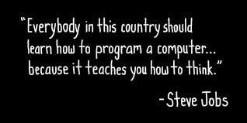
Teach yourself to code
Learn how a computer could help you solve math problems!
You will teach yourself how to code in Python using Codeacademy.com and then apply your skills.
Notes:
Video: http://www.code.org/teach

Slide 7

HIV/AIDS Statistics
Look at HIV prevalence rates by country
Model the data for at least 5 countries using a function
Discuss potential problems with your model or with the data you used
Determine what other questions relating to AIDS that you want to answer.

Slide 8

College tuition Increases
Look at historical tuition amounts at two colleges that you’re interested in attending
Model the data using a function
Discuss potential problems with your model

Slide 9

Space debris
Create several models to predict how much space debris there will be orbiting the Earth at different points of time
Answer guided questions about what your model means

Slide 10
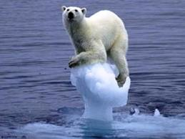
Climate Change – is it real?
Create a model that helps answer the question – is climate change happening?
Think about different variables you can compare to find correlations

Slide 11

Modular arithmetic and encryption
Public key cryptography is a common way to secure information on the Internet, like credit card transmissions. Learn how to encrypt and decrypt using RSA.
In the process, become familiar with modular arithmetic and prime number theory.

Slide 12
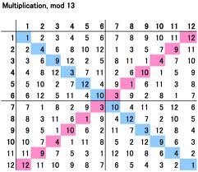
Modular Arithmetic and number theory
Teach yourself modular arithmetic and use it to do complete some proofs.

Slide 13
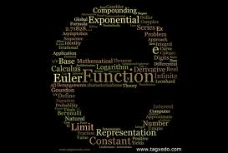
Discover e
Explore e, Euler’s Number, and its various applications
St. Louis Gateway Arch
Transcendental numbers like e and pi
Connections to imaginary numbers

Slide 14
Teach yourself a new math topic
Harmonic Analysis
Given two sinusoids, learn how to form a new graph by adding or multiplying y-coordinates.
Proofs by Induction
Learn how to prove certain types of mathematical properties using mathematical induction.
…or any other topic you’re interested in and make a book!

Slide 15
Schedule
You must choose your project by this Wednesday in office hours
5/6 | 5/7 | 5/8 | 5/9 | 5/10
Check in on Essential Question |  | Math CST |  | Check in on Math Process & Strategies
5/13 | 5/14 | 5/15 | 5/16 | 5/17
 |  |  | Project DUE

Slide 16
Review the Rubric
With your partner, read through the Proficient and Advanced sections
what separates an advanced project from a proficient one?
do you have any questions?

